Slide 1

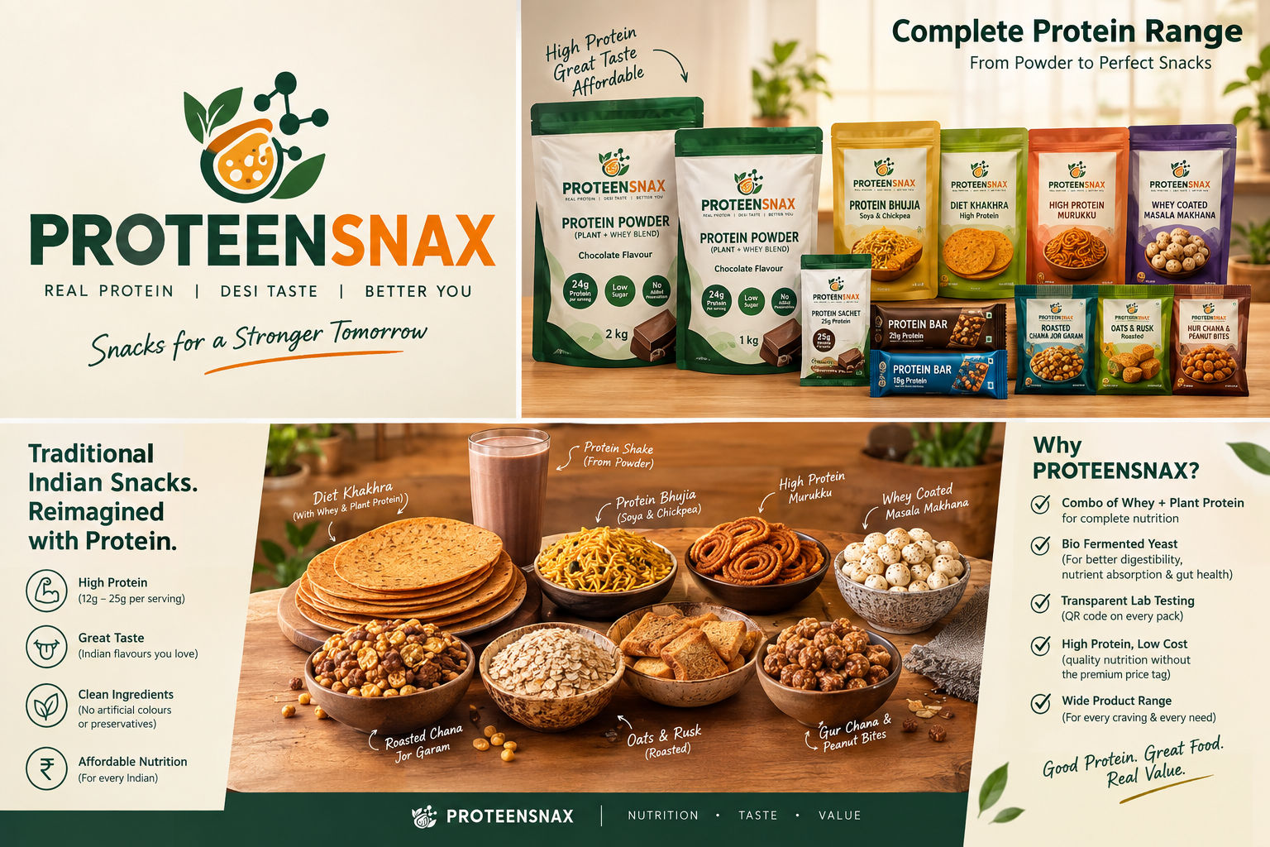

Slide 2
The problem: India has a protein gap
The opportunity is not only fitness — it is everyday nutrition.
73%
surveyed Indians consuming protein-deficient diets (IMRB study)
74%
urban Indians unaware of the right daily protein amount
85%
urban respondents do not track protein intake
71%
willing to switch to more affordable protein alternatives
Protein is often seen as a gym-only product.
Affordability, taste and dietary preferences are major barriers.
Consumers need protein that fits Indian eating habits — not another expensive tub.
PROTEENSNAX | Pitch Deck | 2

Slide 3
Market timing
Protein is moving from niche sports nutrition to mass everyday food.
$912.9M
India protein supplements market, 2025
$1.58B
projected market by 2034
6.27%
reported CAGR, 2026–2034
₹
affordability is a key adoption lever
2026 consumer research: 60% of urban respondents were reported protein-deficient; 71% said they would switch to affordable alternatives.
Plant-based protein is among the fastest-growing segments.
Smaller packs and sachets are already being used to reduce the entry barrier.
PROTEENSNAX | Pitch Deck | 3

Slide 4
The solution: PROTEENSNAX
One brand that makes protein easier to buy, verify and eat every day.
AFFORDABLE
Target price below premium protein brands
✓
VERIFIABLE
QR → batch-wise COA / lab report
✓
INDIAN-FIRST
Protein in familiar snacks & flavours
✓
Core promise: 25g protein options without a premium-only positioning.
Build trust with transparent testing rather than vague 'lab tested' language.
Start D2C + gyms + campuses + modern retail; expand to general trade.
PROTEENSNAX | Pitch Deck | 4

Slide 5
Product portfolio
From a daily shake to Indian-style protein snacking.
Protein Powder
1 kg / 2 kg | 25g protein serving
Protein Sachet
~30–35g fill | 25g protein
Protein Bars
40–70g | 15–20g protein
Protein Bhujia
Soya + chickpea | 10–15g / serving
Diet Khakhra
Whey + plant protein | 10–15g / serving
High-Protein Murukku
Indian savoury | 10–12g / serving
Whey-Coated Masala Makhana
Roasted | 8–12g / serving
Roasted Chana Jor Garam
Roasted chana | 8–12g / serving
Roasted Oats & Rusk
Crunchy snack | 8–12g / serving
Gur Chana + Peanut Bites
Traditional format | 8–10g / serving
PROTEENSNAX | Pitch Deck | 5

Slide 6
The formulation edge: whey + plant + bio-fermented yeast
Use the right protein for the right consumer and format.
• Whey: high-quality dairy protein; strong fit for mainstream performance nutrition.
• Plant blend: soy/chickpea/pea options improve vegetarian accessibility and ingredient flexibility.
• Bio-fermented yeast protein: a newer complete-protein category; food-grade yeast is grown by controlled fermentation and the protein fraction is recovered.
• Position fermentation around digestibility / taste / formulation — avoid unsubstantiated medical claims.
• Final formula and protein claims must be validated by accredited labs and cleared under applicable FSSAI rules.
BIO-FERMENTED YEAST
✓ Complete protein potential
✓ Dairy-free
✓ Soy-free option
✓ Fermentation-led innovation
PROTEENSNAX | Pitch Deck | 6

Slide 7
Trust built into the pack: QR-enabled transparency
A proposed system — not a claim that the startup already has these reports.
Every batch gets a unique QR / batch ID.
Scan → batch COA: protein %, amino-acid profile, microbiology, heavy metals and relevant safety parameters.
Show lab name, test date, sample/batch number and report PDF.
Use independent accredited testing where practical; maintain a public verification trail.
The QR becomes a brand trust asset — 'Don't just believe the label. Verify the batch.'
SCAN → VERIFY
PROTEENSNAX | Pitch Deck | 7

Slide 8
Proposed launch pricing
Illustrative target MRPs — validate with supplier quotes, GST, packaging and channel margins.
Protein Powder 1 kg
~25g/serve
₹1,599
Protein Powder 2 kg
~25g/serve
₹2,899
25g Protein Sachet
1 serving
₹69–79
Protein Bar
15g protein
₹59
Protein Bar Pro
20g protein
₹79
Protein Bhujia
100g
₹79
Diet Khakhra
100g
₹89
High-Protein Murukku
100g
₹99
Whey Masala Makhana
60g
₹99
Roasted Chana Jor Garam
100g
₹59
Roasted Oats & Rusk
100g
₹69
Gur Chana + Peanut Bites
100g
₹69
PROTEENSNAX | Pitch Deck | 8

Slide 9
Illustrative unit economics: 1 kg powder
Target economics — final COGS depends on formulation, protein source, MOQ and channel.
₹1,599
target MRP
₹780–900
target landed COGS
₹699–819
gross contribution before selling/channel costs
44–51%
illustrative gross margin on MRP
COGS bucket: protein ingredients + flavour system + sweetener + packaging + manufacturing + QC + freight.
Direct-to-consumer gives better early economics; marketplace/retail needs distributor + retailer margins.
Sachets are acquisition SKUs; 1 kg / 2 kg packs are retention & margin SKUs.
Do not promise margins until supplier quotations and a pilot batch are completed.
PROTEENSNAX | Pitch Deck | 9

Slide 10
Competitive landscape: where PROTEENSNAX can win
Current prices are observed online and can change with promotions.
Brand / format
Observed price
What they do well
Our opportunity
MuscleBlaze whey 1kg
~₹3,999
Strong gym brand + whey
Mass affordability + everyday snacks
Amul whey sachets
₹2,400 / 30×32g
Accessible sachet format
More flavours + broader snack ecosystem + QR COA
Yoga Bar 20g bar
₹125 single
Mass snack distribution
Indian savoury protein range + lower target price
The Whole Truth 20g Pro
₹825 / 5
Clean-label positioning
Price accessibility + traditional Indian formats
PROTEENSNAX | Pitch Deck | 10

Slide 11
Why customers choose us
The moat is not 'cheap protein' — it is trust + formats + affordability.
01 25g protein access
A clear serving promise across powder + sachet formats.
02 Batch-level proof
QR-linked COA creates visible quality transparency.
03 Indian snack innovation
Bhujia, khakhra, murukku, makhana, chana & bites.
04 Multi-protein platform
Whey + plant + bio-fermented yeast formulations.
05 Price ladder
₹59 snack → ₹79 sachet → ₹1,599 powder.
06 Education-led brand
Protein calculator, QR education and simple serving guidance.
PROTEENSNAX | Pitch Deck | 11

Slide 12
Go-to-market: prove before scaling
Start narrow, learn fast, then expand.
Phase 1 — 90 days: D2C website + Instagram + 5–10 gyms + college campuses; launch sachet + 1kg powder + 3 snacks.
Phase 2 — 6–12 months: marketplaces, nutrition stores, cafés and regional modern trade.
Sampling: ₹69–79 sachet as the first trial; bundle '7-day protein snack challenge'.
Retention: monthly powder subscription + snack box; QR results and batch stories reinforce trust.
Measure: repeat purchase, CAC, gross margin, sachet-to-tub conversion, complaints, taste score and protein-per-rupee.
PROTEENSNAX | Pitch Deck | 12

Slide 13
Business model & scale
A portfolio model reduces dependence on a single protein SKU.
Powder
High ticket + repeat purchase
Sachets
Low-risk trial + sampling
Bars
Impulse / on-the-go
Indian snacks
High-frequency everyday consumption
B2B
Gyms, colleges, offices, cafés
Long-term: build a 'protein operating system' — one verified ingredient platform powering multiple affordable formats.
Potential moat: formulation know-how + supplier network + batch transparency + consumer data + Indian taste library.
PROTEENSNAX | Pitch Deck | 13

Slide 14
CAPEX & OPEX — 90-Day Pilot Budget
₹10 LAKH
Pilot budget
Illustrative allocation of the ₹10 lakh pilot budget; validate with vendor quotes before launch.
CAPEX
₹2.5 LAKH
OPEX
₹7.5 LAKH
✓
Basic production / packing equipment
✓
Formulation & accredited lab testing
✓
Initial testing & QC setup
✓
Raw materials + packaging for pilot
✓
Website, domain & essential tech setup
✓
Sampling, digital marketing & launch
✓
Reusable launch assets
✓
Logistics, admin & team operating costs
Budget logic: keep fixed investment lean by using contract manufacturing, and put more cash into product validation + customer acquisition.
PROTEENSNAX | Pitch Deck | 14

Slide 15
THE ASK
Build the first affordable, verifiable Indian protein-snacking brand.
Pilot formulation + accredited lab testing
₹10–15 lakh pre-seed target for prototype, testing, packaging, sampling & D2C launch
90-day proof: 1,000 paid customers + repeat-rate and unit-economics validation
Scale only after taste, safety, repeat purchase and gross margin are proven
PROTEENSNAX • Good Protein. Great Food. Real Value.
PROTEENSNAX | Pitch Deck | 15

